Slide 1
BST264 Empirical Finance Lecture 2 Cross-Sectional Data Models I
Dr Peng Zhou (Joe)
pzhou@cardiffmet.ac.uk

Slide 2
Introduction
We have seen where we are in the big picture: empirical finance is a tool to verify or falsify finance theory.
It is more an inductive reasoning process, based on both stochastic analysis and statistical analysis.
It is about confronting data against data generating process (DGP), including descriptive and inferential (test and estimation) procedures.
We will start with the simplest data type—cross-sectional data and the associated methods and techniques in practice, covering:
Classical Linear Regression Model (LRM): assumptions, estimation/test, properties
Extensions: Generalised Linear Model (GLM), Multivariate Regression Model, etc.
Applications
I am going to focus on intuition and application. If you are really a fan of strict mathematical derivation, ask me in person and I promise that you will never be disappointed!

Slide 3
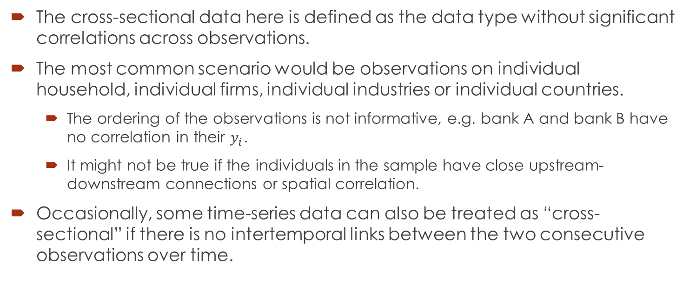
Introduction
The cross-sectional data here is defined as the data type without significant correlations across observations.
The most common scenario would be observations on individual household, individual firms, individual industries or individual countries.
The ordering of the observations is not informative, e.g. bank A and bank B have no correlation in their $y_{i}$.
It might not be true if the individuals in the sample have close upstream-downstream connections or spatial correlation.
Occasionally, some time-series data can also be treated as “cross-sectional” if there is no intertemporal links between the two consecutive observations over time.

Slide 4
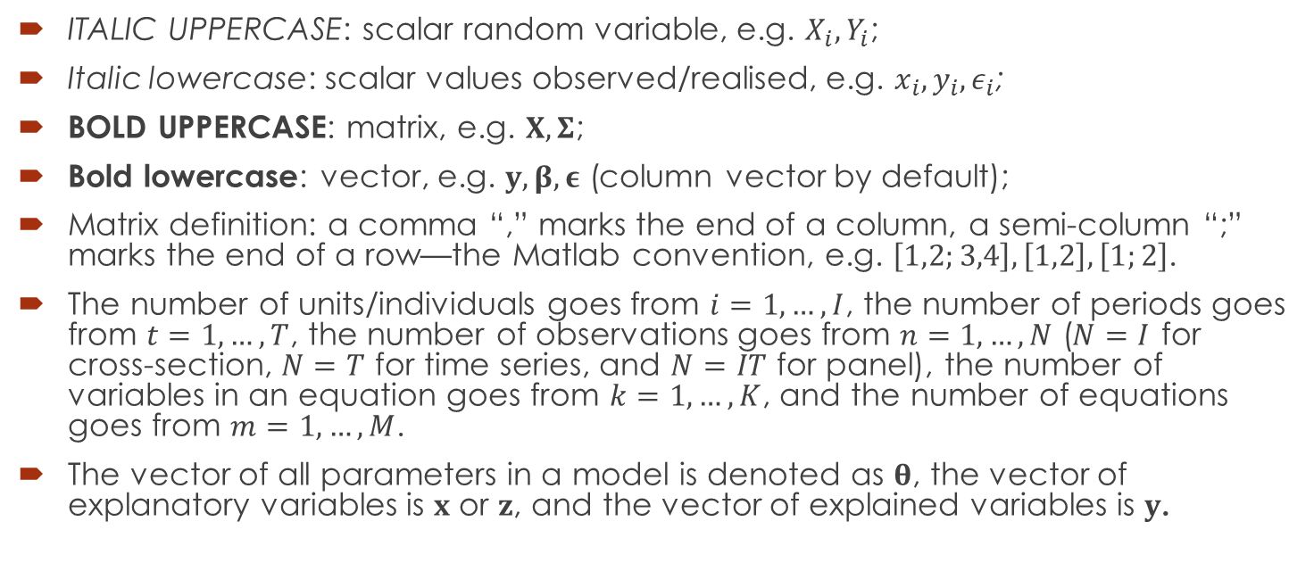
Notations and Conventions
ITALIC UPPERCASE: scalar random variable, e.g. $X_{i},Y_{i}$;
Italic lowercase: scalar values observed/realised, e.g. $x_{i},y_{i},ε_{i}$;
BOLD UPPERCASE: matrix, e.g. $X,Σ$;
Bold lowercase: vector, e.g. $y,β,ε$ (column vector by default);
Matrix definition: a comma “,” marks the end of a column, a semi-column “;” marks the end of a row—the Matlab convention, e.g. $\left[1,2;3,4\right],\left[1,2\right],\left[1;2\right]$.
The number of units/individuals goes from $i=1,…,I$, the number of periods goes from $t=1,…,T$, the number of observations goes from $n=1,…,N$ ($N=I$ for cross-section, $N=T$ for time series, and $N=IT$ for panel), the number of variables in an equation goes from $k=1,…,K$, and the number of equations goes from $m=1,…,M$.
The vector of all parameters in a model is denoted as $θ$, the vector of explanatory variables is $x$ or $z$, and the vector of explained variables is $y$.

Slide 5
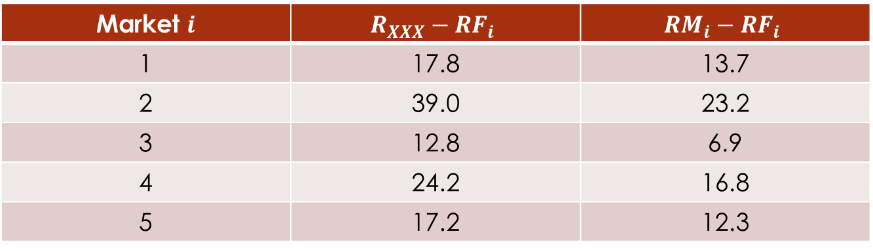
An Introductory Example
Assume you are a fund manager ☺ (“fund XXX”) in an international investment bank and your assistant ☹ collects the following data on the excess returns on your portfolios in 5 countries and the excess returns on the market indices:
Market $i$ | $$R_{XXX}−{RF}_{i}$$ | $$RM_{i}−RF_{i}$$
1 | 17.8 | 13.7
2 | 39.0 | 23.2
3 | 12.8 | 6.9
4 | 24.2 | 16.8
5 | 17.2 | 12.3
You need to report to your clients on your portfolio performance: profitability (easy!) and risk.
You have some intuition that your portfolios are positively correlated with the markets.
Therefore, the CAPM theory could be used to measure the systematic risk, aka “beta”.

Slide 6
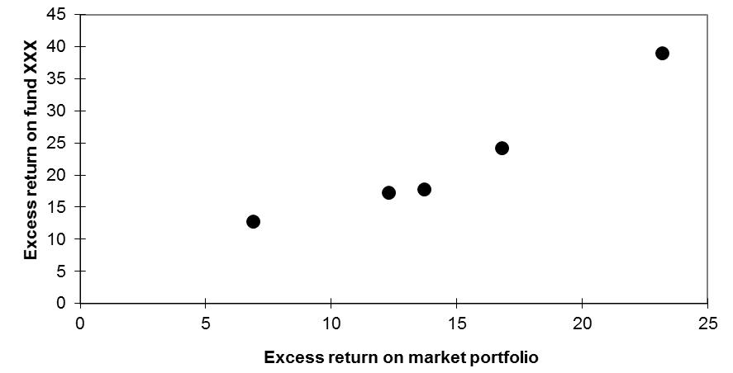
An Introductory Example
You can begin with a descriptive analysis, simply drawing a scatter plot of the two variables. By eyeballing it, it seems quite positively correlated, but your client may challenge you:
How much positive?
And is this positive relationship significant or just by chance?

Slide 7
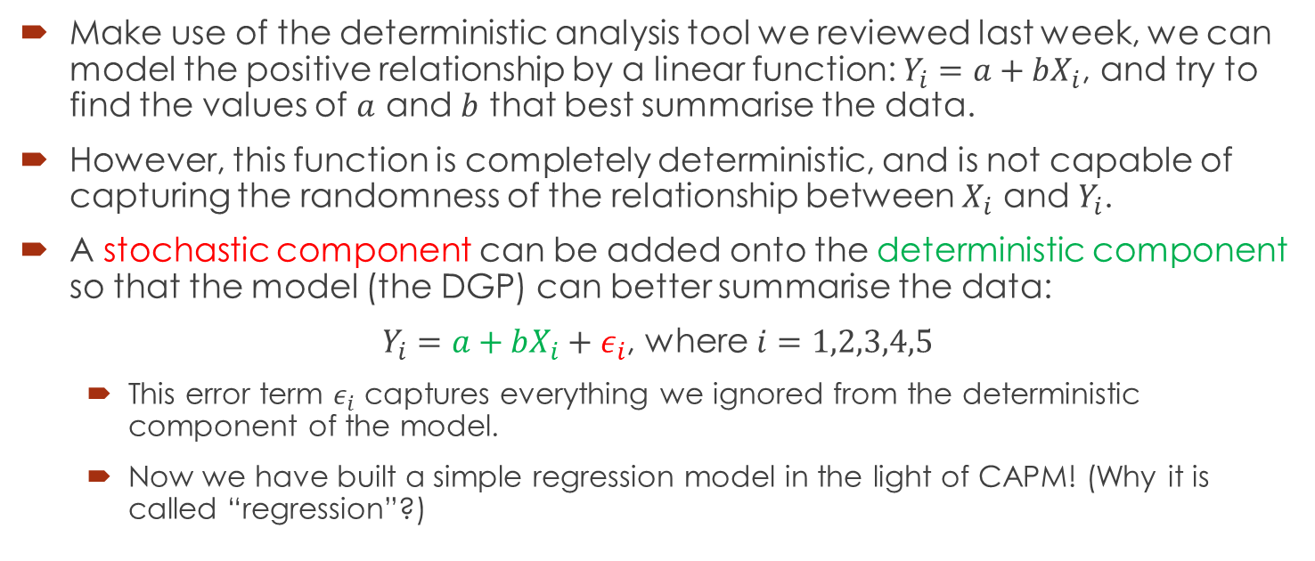
An Introductory Example
Make use of the deterministic analysis tool we reviewed last week, we can model the positive relationship by a linear function: $Y_{i}=a+bX_{i}$, and try to find the values of $a$ and $b$ that best summarise the data.
However, this function is completely deterministic, and is not capable of capturing the randomness of the relationship between $X_{i}$ and $Y_{i}$.
A stochastic component can be added onto the deterministic component so that the model (the DGP) can better summarise the data:
$Y_{i}=a+bX_{i}+ε_{i}$, where $i=1,2,3,4,5$
This error term $ε_{i}$ captures everything we ignored from the deterministic component of the model.
Now we have built a simple regression model in the light of CAPM! (Why it is called “regression”?)

Slide 8
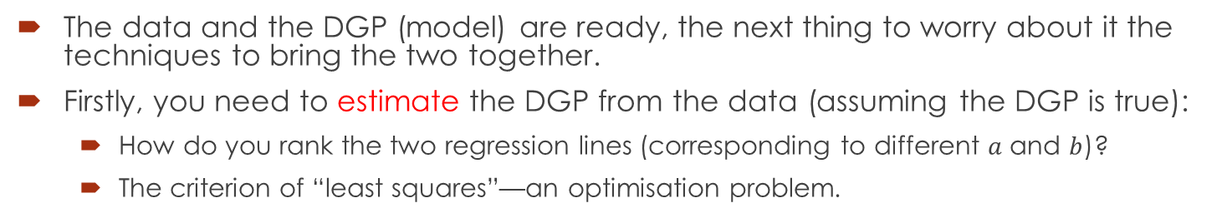
An Introductory Example
The data and the DGP (model) are ready, the next thing to worry about it the techniques to bring the two together.
Firstly, you need to estimate the DGP from the data (assuming the DGP is true):
How do you rank the two regression lines (corresponding to different $a$ and $b$)?
The criterion of “least squares”—an optimisation problem.

Slide 9
An Introductory Example
The data and the DGP (model) are ready, the next thing to worry about it the techniques to bring the two together.
Secondly, how do you know the DGP is true? So you need to test all the assumptions underlying the estimation—if some fail to hold, you will have to make changes and iterate until the conclusion is robust.
Specification, endogeneity, heteroscedasticity, serial correlation, etc.

Slide 10
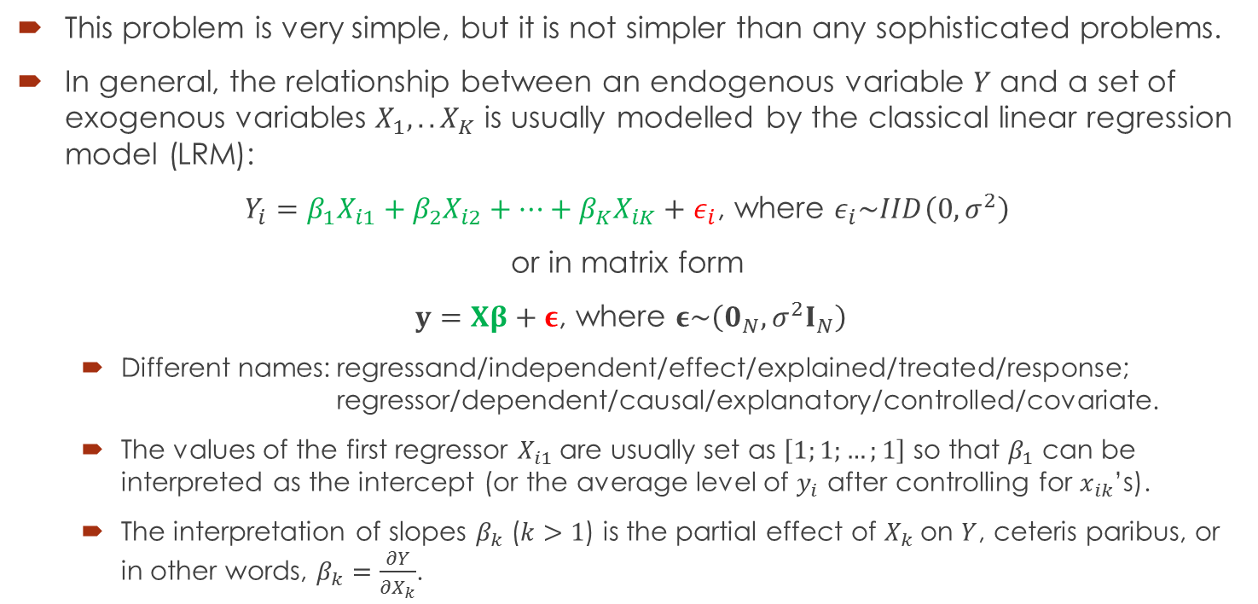
The Classical Linear Regression Model —The Structure
This problem is very simple, but it is not simpler than any sophisticated problems.
In general, the relationship between an endogenous variable $Y$ and a set of exogenous variables $X_{1},..X_{K}$ is usually modelled by the classical linear regression model (LRM):
$Y_{i}=β_{1}X_{i1}+β_{2}X_{i2}+…+β_{K}X_{iK}+ε_{i}$, where $ε_{i}\sim IID\left(0,σ^{2}\right)$
or in matrix form
$y=Xβ+ε$, where $ε\sim \left(0_{N},σ^{2}I_{N}\right)$
Different names: regressand/independent/effect/explained/treated/response; regressor/dependent/causal/explanatory/controlled/covariate.
The values of the first regressor $X_{i1}$ are usually set as $\left[1;1;…;1\right]$ so that $β_{1}$ can be interpreted as the intercept (or the average level of $y_{i}$ after controlling for $x_{ik}$’s).
The interpretation of slopes $β_{k}$ ($k>1$) is the partial effect of $X_{k}$ on $Y$, ceteris paribus, or in other words, $β_{k}=\frac{∂Y}{∂X_{k}}$.

Slide 11
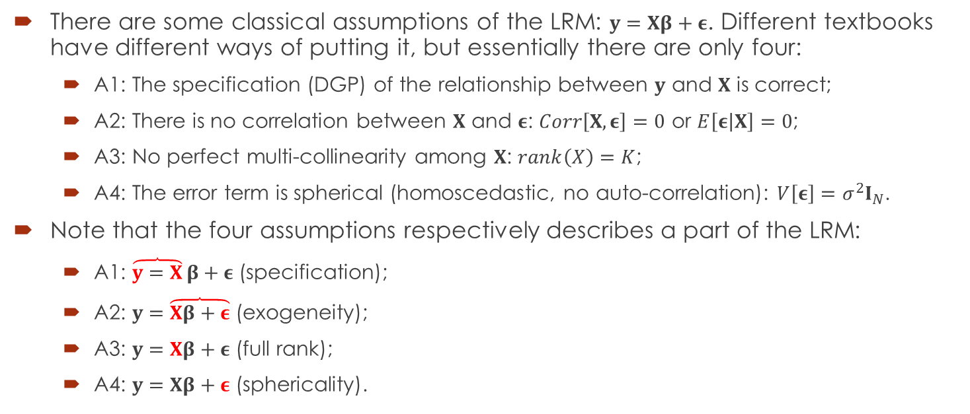
The Classical Linear Regression Model —The Assumptions
There are some classical assumptions of the LRM: $y=Xβ+ε$. Different textbooks have different ways of putting it, but essentially there are only four:
A1: The specification (DGP) of the relationship between $y$ and $X$ is correct;
A2: There is no correlation between $X$ and $ε$: $Corr\left[X,ε\right]=0$ or $E\left[ε\left|X\right.\right]=0$;
A3: No perfect multi-collinearity among $X$: $rank\left(X\right)=K$;
A4: The error term is spherical (homoscedastic, no auto-correlation): $V\left[ε\right]=σ^{2}I_{N}$.
Note that the four assumptions respectively describes a part of the LRM:
A1: $\overbrace{y=X}β+ε$ (specification);
A2: $y=\overbrace{Xβ+ε}$ (exogeneity);
A3: $y=Xβ+ε$ (full rank);
A4: $y=Xβ+ε$ (sphericality).

Slide 12
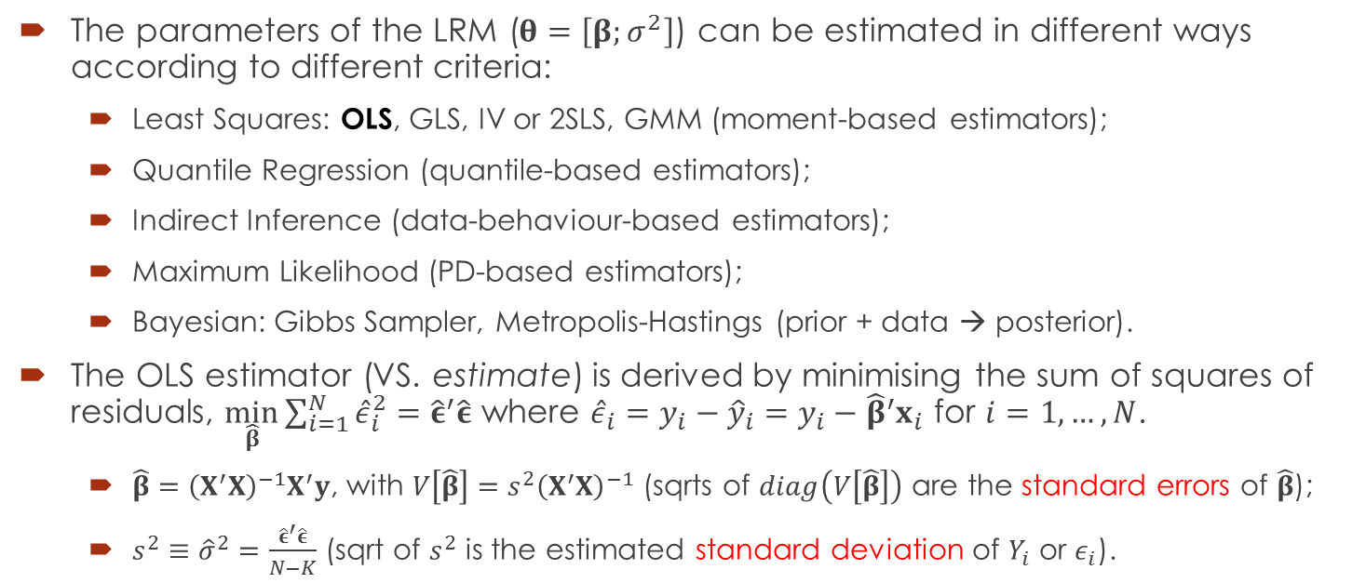
The Classical Linear Regression Model —Estimation
The parameters of the LRM ($θ=\left[β;σ^{2}\right]$) can be estimated in different ways according to different criteria:
Least Squares: OLS, GLS, IV or 2SLS, GMM (moment-based estimators);
Quantile Regression (quantile-based estimators);
Indirect Inference (data-behaviour-based estimators);
Maximum Likelihood (PD-based estimators);
Bayesian: Gibbs Sampler, Metropolis-Hastings (prior + data → posterior).
The OLS estimator (VS. estimate) is derived by minimising the sum of squares of residuals, $\min_{\hat{β}}{\sum_{i=1}^{N}{{\hat{ε}}_{i}^{2}}={\hat{ε}}^{′}\hat{ε}}$ where ${\hat{ε}}_{i}=y_{i}−{\hat{y}}_{i}=y_{i}−{\hat{β}}^{′}x_{i}$ for $i=1,…,N$.
$\hat{β}={\left(X^{′}X\right)}^{−1}X^{′}y$, with $V\left[\hat{β}\right]=s^{2}{\left(X^{′}X\right)}^{−1}$ (sqrts of $diag\left(V\left[\hat{β}\right]\right)$ are the standard errors of $\hat{β}$);
$s^{2}≡{\hat{σ}}^{2}=\frac{{\hat{ε}}^{′}\hat{ε}}{N−K}$ (sqrt of $s^{2}$ is the estimated standard deviation of $Y_{i}$ or $ε_{i}$).

Slide 13
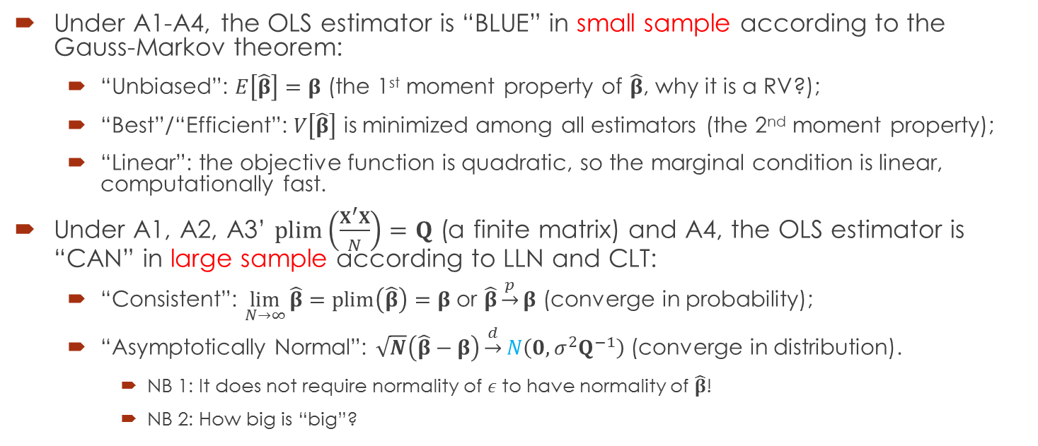
The Classical Linear Regression Model —The Properties (of the Estimator)
Under A1-A4, the OLS estimator is “BLUE” in small sample according to the Gauss-Markov theorem:
“Unbiased”: $E\left[\hat{β}\right]=β$ (the 1st moment property of $\hat{β}$, why it is a RV?);
“Best”/“Efficient”: $V\left[\hat{β}\right]$ is minimized among all estimators (the 2nd moment property);
“Linear”: the objective function is quadratic, so the marginal condition is linear, computationally fast.
Under A1, A2, A3’ $plim\left(\frac{X^{′}X}{N}\right)=Q$ (a finite matrix) and A4, the OLS estimator is “CAN” in large sample according to LLN and CLT:
“Consistent”: $\lim_{N→∞}{\hat{β}}=plim\left(\hat{β}\right)=β$ or $\hat{β}\underset{→}{p}β$ (converge in probability);
“Asymptotically Normal”: $\sqrt{N}\left(\hat{β}−β\right)\underset{→}{d}N\left(0,σ^{2}Q^{−1}\right)$ (converge in distribution).
NB 1: It does not require normality of $ε$ to have normality of $\hat{β}$!
NB 2: How big is “big”?

Slide 14
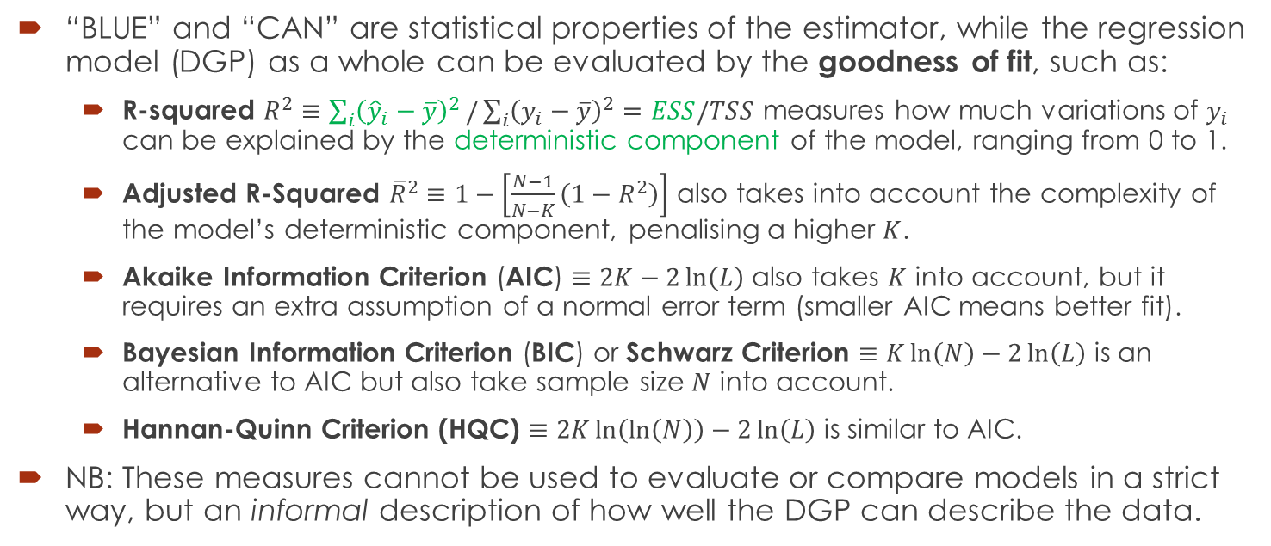
The Classical Linear Regression Model —The Properties (of the Model)
“BLUE” and “CAN” are statistical properties of the estimator, while the regression model (DGP) as a whole can be evaluated by the goodness of fit, such as:
R-squared $R^{2}≡\sum_{i}{{\left({\hat{y}}_{i}−\overline{y}\right)}^{2}}/\sum_{i}{{\left(y_{i}−\overline{y}\right)}^{2}}=ESS/TSS$ measures how much variations of $y_{i}$ can be explained by the deterministic component of the model, ranging from 0 to 1.
Adjusted R-Squared ${\overline{R}}^{2}≡1−\left[\frac{N−1}{N−K}\left(1−R^{2}\right)\right]$ also takes into account the complexity of the model’s deterministic component, penalising a higher $K$.
Akaike Information Criterion (AIC) $≡2K−2\ln\left(L\right)$ also takes $K$ into account, but it requires an extra assumption of a normal error term (smaller AIC means better fit).
Bayesian Information Criterion (BIC) or Schwarz Criterion $≡K\ln\left(N\right)−2\ln\left(L\right)$ is an alternative to AIC but also take sample size $N$ into account.
Hannan-Quinn Criterion (HQC) $≡2K\ln\left(\ln\left(N\right)\right)−2\ln\left(L\right)$ is similar to AIC.
NB: These measures cannot be used to evaluate or compare models in a strict way, but an informal description of how well the DGP can describe the data.

Slide 15

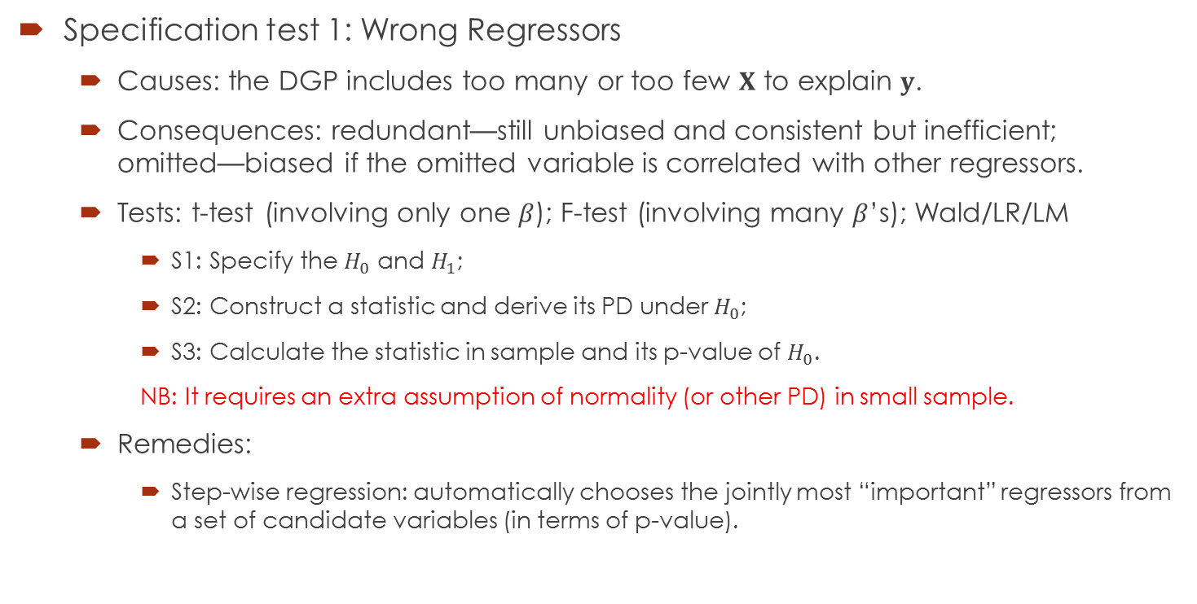
The Classical Linear Regression Model —Test of A1
$\overbrace{y=X}β+ε$
Specification test 1: Wrong Regressors
Causes: the DGP includes too many or too few $X$ to explain $y$.
Consequences: redundant—still unbiased and consistent but inefficient; omitted—biased if the omitted variable is correlated with other regressors.
Tests: t-test (involving only one $β$); F-test (involving many $β$’s); Wald/LR/LM
S1: Specify the $H_{0}$ and $H_{1}$;
S2: Construct a statistic and derive its PD under $H_{0}$;
S3: Calculate the statistic in sample and its p-value of $H_{0}$.
NB: It requires an extra assumption of normality (or other PD) in small sample.
Remedies:
Step-wise regression: automatically chooses the jointly most “important” regressors from a set of candidate variables (in terms of p-value).

Slide 16

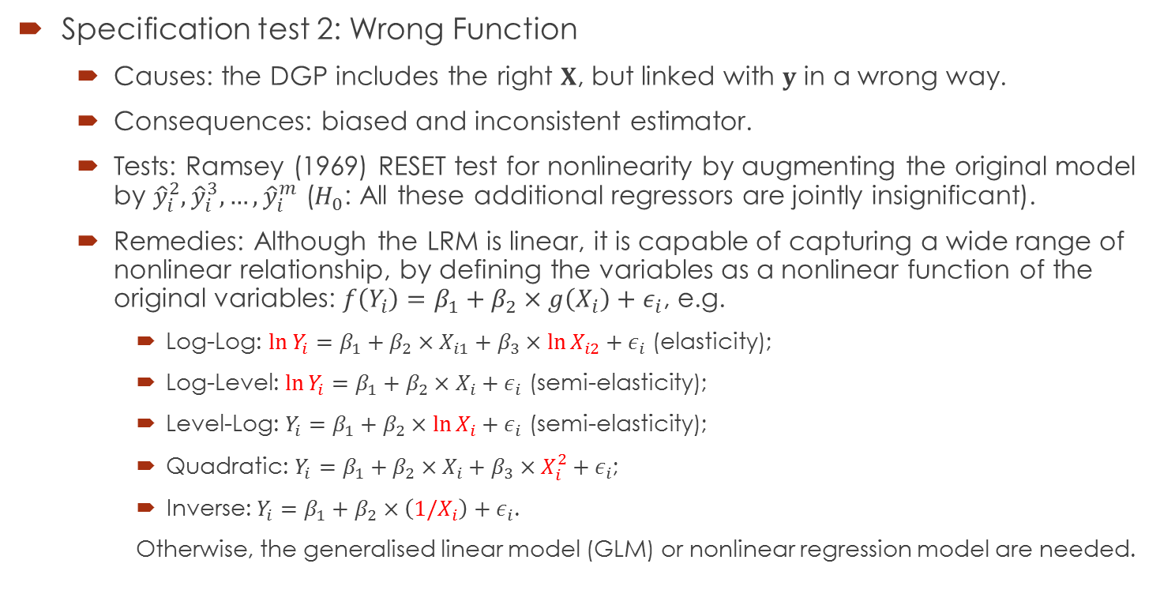
The Classical Linear Regression Model —Test of A1
$\overbrace{y=X}β+ε$
Specification test 2: Wrong Function
Causes: the DGP includes the right $X$, but linked with $y$ in a wrong way.
Consequences: biased and inconsistent estimator.
Tests: Ramsey (1969) RESET test for nonlinearity by augmenting the original model by ${\hat{y}}_{i}^{2},{\hat{y}}_{i}^{3},…,{\hat{y}}_{i}^{m}$ ($H_{0}$: All these additional regressors are jointly insignificant).
Remedies: Although the LRM is linear, it is capable of capturing a wide range of nonlinear relationship, by defining the variables as a nonlinear function of the original variables: $f\left(Y_{i}\right)=β_{1}+β_{2}×g\left(X_{i}\right)+ε_{i}$, e.g.
Log-Log: $\ln{Y_{i}}=β_{1}+β_{2}×X_{i1}+β_{3}×\ln{X_{i2}}+ε_{i}$ (elasticity);
Log-Level: $\ln{Y_{i}}=β_{1}+β_{2}×X_{i}+ε_{i}$ (semi-elasticity);
Level-Log: $Y_{i}=β_{1}+β_{2}×\ln{X_{i}}+ε_{i}$ (semi-elasticity);
Quadratic: $Y_{i}=β_{1}+β_{2}×X_{i}+β_{3}×X_{i}^{2}+ε_{i}$;
Inverse: $Y_{i}=β_{1}+β_{2}×\left(1/X_{i}\right)+ε_{i}$.
Otherwise, the generalised linear model (GLM) or nonlinear regression model are needed.
How to interpret $β$?

Slide 17

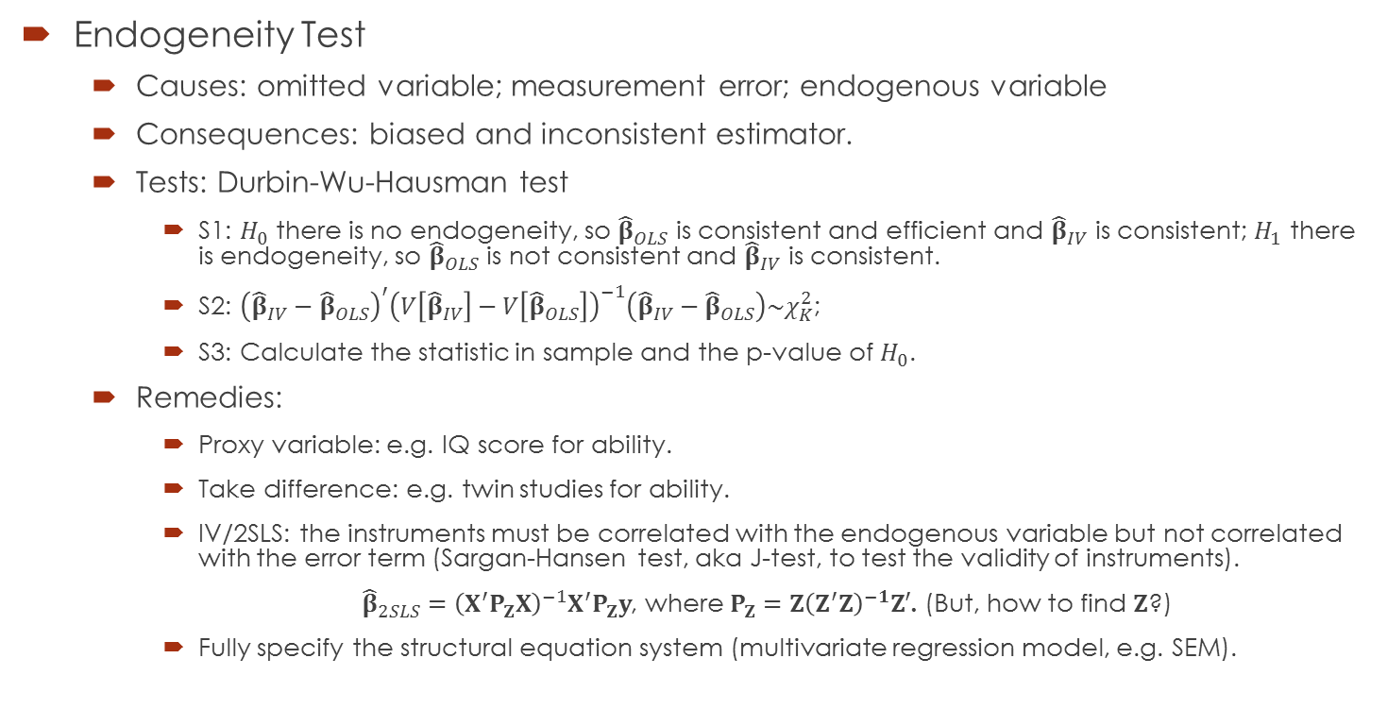
The Classical Linear Regression Model —Test of A2
$$y=\overbrace{Xβ+ε}$$
Endogeneity Test
Causes: omitted variable; measurement error; endogenous variable
Consequences: biased and inconsistent estimator.
Tests: Durbin-Wu-Hausman test
S1: $H_{0}$ there is no endogeneity, so ${\hat{β}}_{OLS}$ is consistent and efficient and ${\hat{β}}_{IV}$ is consistent; $H_{1}$ there is endogeneity, so ${\hat{β}}_{OLS}$ is not consistent and ${\hat{β}}_{IV}$ is consistent.
S2: ${\left({\hat{β}}_{IV}−{\hat{β}}_{OLS}\right)}^{′}{\left(V\left[{\hat{β}}_{IV}\right]−V\left[{\hat{β}}_{OLS}\right]\right)}^{−1}\left({\hat{β}}_{IV}−{\hat{β}}_{OLS}\right)\sim χ_{K}^{2}$;
S3: Calculate the statistic in sample and the p-value of $H_{0}$.
Remedies:
Proxy variable: e.g. IQ score for ability.
Take difference: e.g. twin studies for ability.
IV/2SLS: the instruments must be correlated with the endogenous variable but not correlated with the error term (Sargan-Hansen test, aka J-test, to test the validity of instruments).
${\hat{β}}_{2SLS}={\left(X^{′}P_{Z}X\right)}^{−1}X^{′}P_{Z}y$, where $P_{Z}=Z{\left(Z^{′}Z\right)}^{−1}Z′$. (But, how to find $Z$?)
Fully specify the structural equation system (multivariate regression model, e.g. SEM).

Slide 18

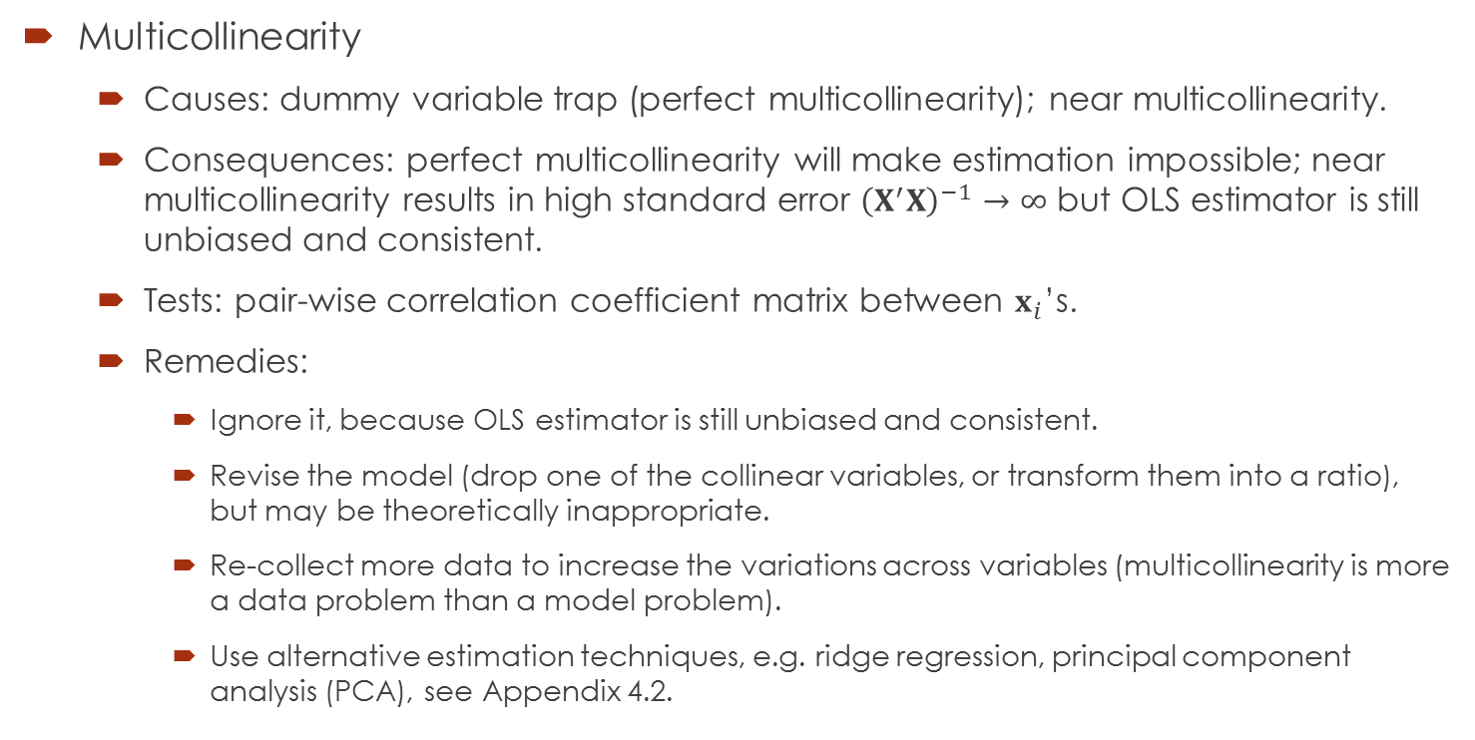
The Classical Linear Regression Model —Test of A3
$$y=Xβ+ε$$
Multicollinearity
Causes: dummy variable trap (perfect multicollinearity); near multicollinearity.
Consequences: perfect multicollinearity will make estimation impossible; near multicollinearity results in high standard error ${\left(X^{′}X\right)}^{−1}→∞$ but OLS estimator is still unbiased and consistent.
Tests: pair-wise correlation coefficient matrix between $x_{i}$’s.
Remedies:
Ignore it, because OLS estimator is still unbiased and consistent.
Revise the model (drop one of the collinear variables, or transform them into a ratio), but may be theoretically inappropriate.
Re-collect more data to increase the variations across variables (multicollinearity is more a data problem than a model problem).
Use alternative estimation techniques, e.g. ridge regression, principal component analysis (PCA), see Appendix 4.2.

Slide 19
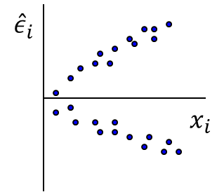

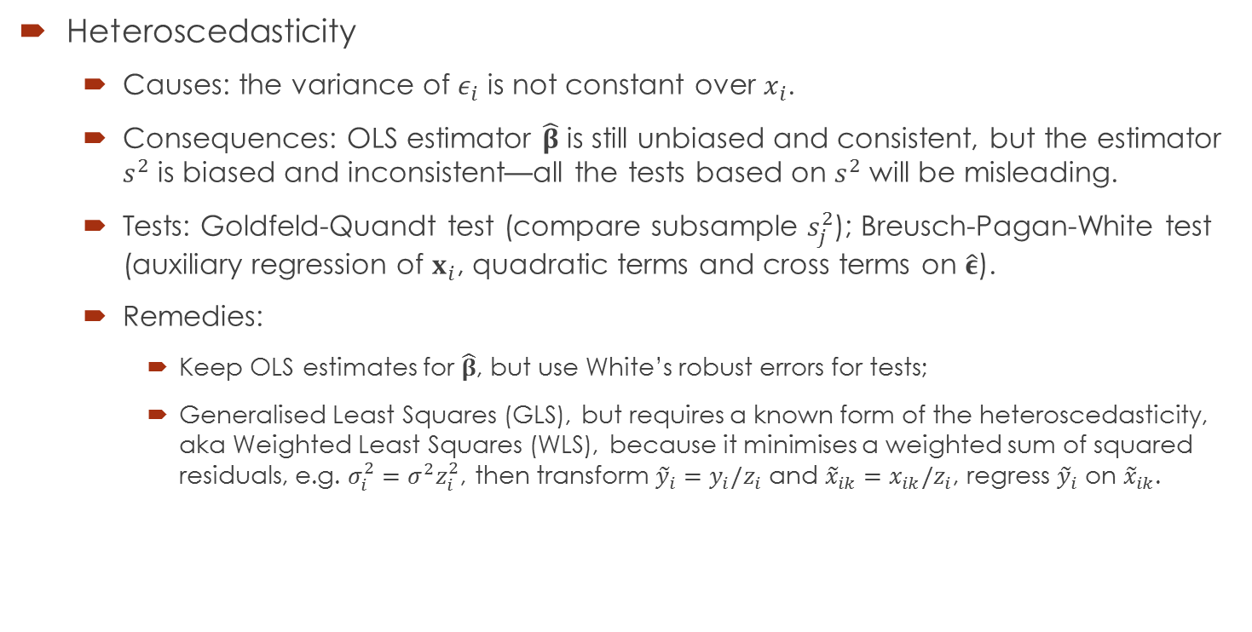
The Classical Linear Regression Model —Test of A4
$$y=Xβ+ε$$
Heteroscedasticity
Causes: the variance of $ε_{i}$ is not constant over $x_{i}$.
Consequences: OLS estimator $\hat{β}$ is still unbiased and consistent, but the estimator $s^{2}$ is biased and inconsistent—all the tests based on $s^{2}$ will be misleading.
Tests: Goldfeld-Quandt test (compare subsample $s_{j}^{2}$); Breusch-Pagan-White test (auxiliary regression of $x_{i}$, quadratic terms and cross terms on $\hat{ε}$).
Remedies:
Keep OLS estimates for $\hat{β}$, but use White’s robust errors for tests;
Generalised Least Squares (GLS), but requires a known form of the heteroscedasticity, aka Weighted Least Squares (WLS), because it minimises a weighted sum of squared residuals, e.g. $σ_{i}^{2}=σ^{2}z_{i}^{2}$, then transform ${\tilde{y}}_{i}=y_{i}/z_{i}$ and ${\tilde{x}}_{ik}=x_{ik}/z_{i}$, regress ${\tilde{y}}_{i}$ on ${\tilde{x}}_{ik}$.

Slide 20
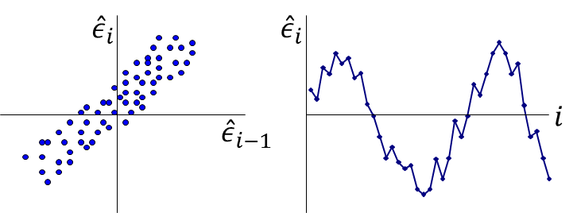
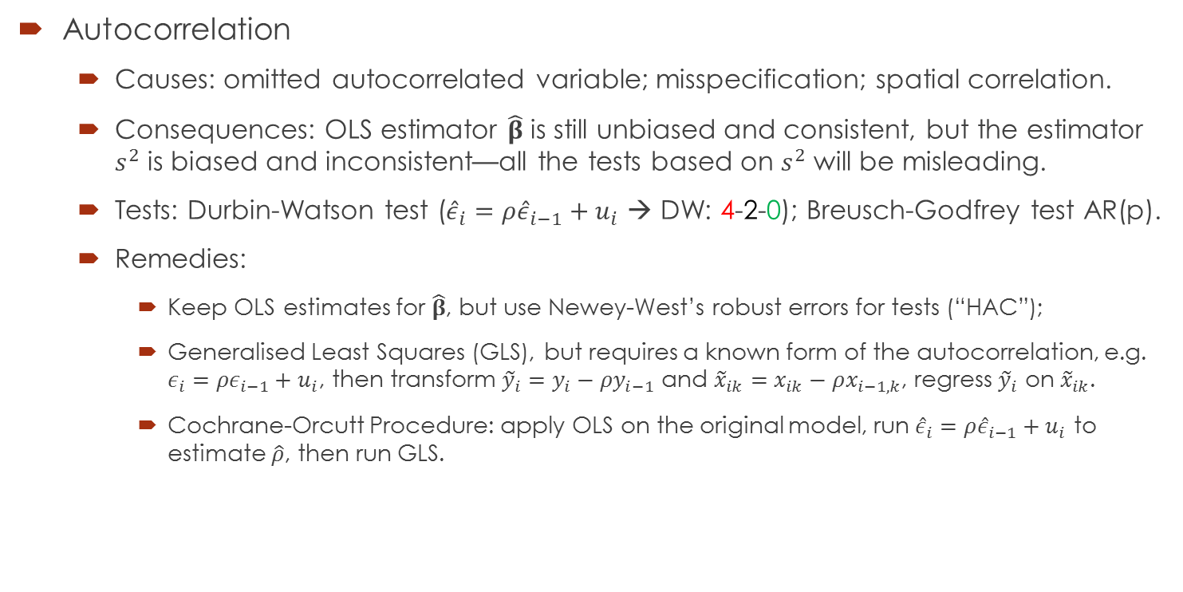
The Classical Linear Regression Model —Test of A4
$$y=Xβ+ε$$
Autocorrelation
Causes: omitted autocorrelated variable; misspecification; spatial correlation.
Consequences: OLS estimator $\hat{β}$ is still unbiased and consistent, but the estimator $s^{2}$ is biased and inconsistent—all the tests based on $s^{2}$ will be misleading.
Tests: Durbin-Watson test (${\hat{ε}}_{i}=ρ{\hat{ε}}_{i−1}+u_{i}$ → DW: 4-2-0); Breusch-Godfrey test AR(p).
Remedies:
Keep OLS estimates for $\hat{β}$, but use Newey-West’s robust errors for tests (“HAC”);
Generalised Least Squares (GLS), but requires a known form of the autocorrelation, e.g. $ε_{i}=ρε_{i−1}+u_{i}$, then transform ${\tilde{y}}_{i}=y_{i}−ρy_{i−1}$ and ${\tilde{x}}_{ik}=x_{ik}−ρx_{i−1,k}$, regress ${\tilde{y}}_{i}$ on ${\tilde{x}}_{ik}$.
Cochrane-Orcutt Procedure: apply OLS on the original model, run ${\hat{ε}}_{i}=ρ{\hat{ε}}_{i−1}+u_{i}$ to estimate $\hat{ρ}$, then run GLS.

Slide 21
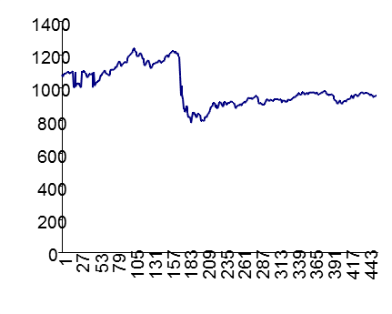
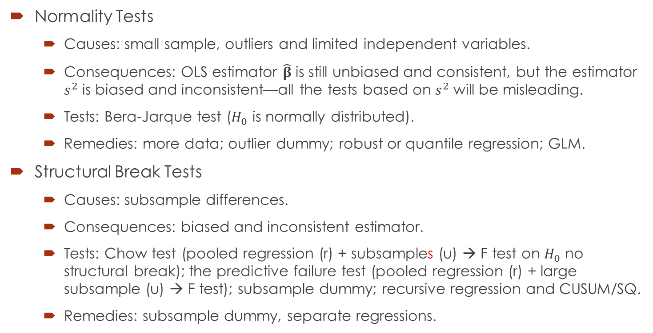
The Classical Linear Regression Model —Other Diagnostic Tests
Normality Tests
Causes: small sample, outliers and limited independent variables.
Consequences: OLS estimator $\hat{β}$ is still unbiased and consistent, but the estimator $s^{2}$ is biased and inconsistent—all the tests based on $s^{2}$ will be misleading.
Tests: Bera-Jarque test ($H_{0}$ is normally distributed).
Remedies: more data; outlier dummy; robust or quantile regression; GLM.
Structural Break Tests
Causes: subsample differences.
Consequences: biased and inconsistent estimator.
Tests: Chow test (pooled regression (r) + subsamples (u) → F test on $H_{0}$ no structural break); the predictive failure test (pooled regression (r) + large subsample (u) → F test); subsample dummy; recursive regression and CUSUM/SQ.
Remedies: subsample dummy, separate regressions.

Slide 22
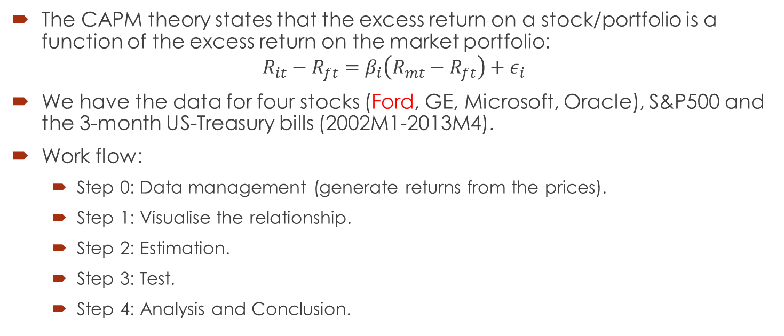
Example 1: Estimate and Test the CAPM
The CAPM theory states that the excess return on a stock/portfolio is a function of the excess return on the market portfolio:
$$R_{it}−R_{ft}=β_{i}\left(R_{mt}−R_{ft}\right)+ε_{i}$$
We have the data for four stocks (Ford, GE, Microsoft, Oracle), S&P500 and the 3-month US-Treasury bills (2002M1-2013M4).
Work flow:
Step 0: Data management (generate returns from the prices).
Step 1: Visualise the relationship.
Step 2: Estimation.
Step 3: Test.
Step 4: Analysis and Conclusion.

Slide 23
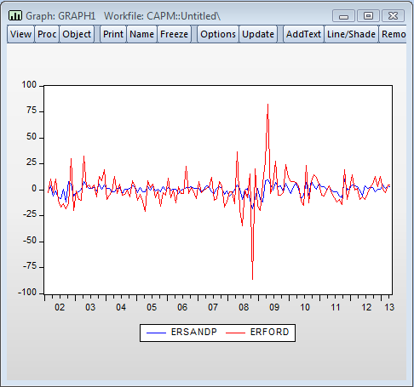
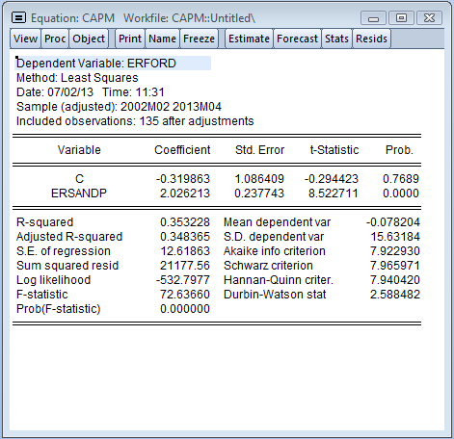
Example 1: Estimate and Test the CAPM

Slide 24
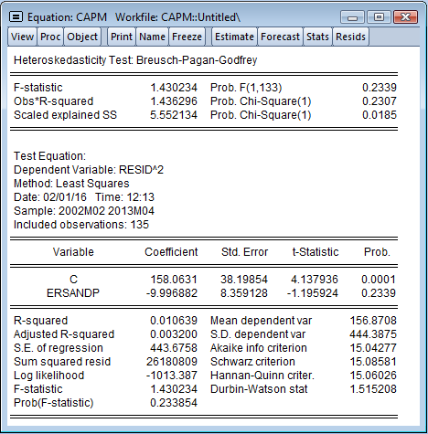
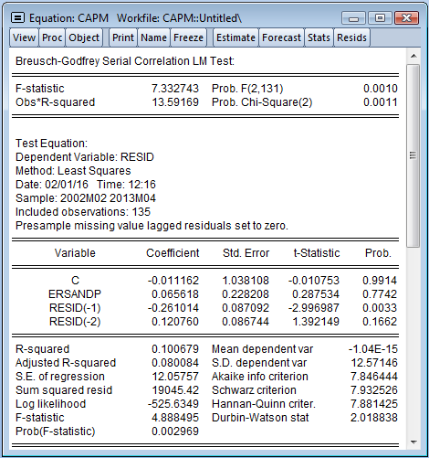
Example 1: Estimate and Test the CAPM

Slide 25
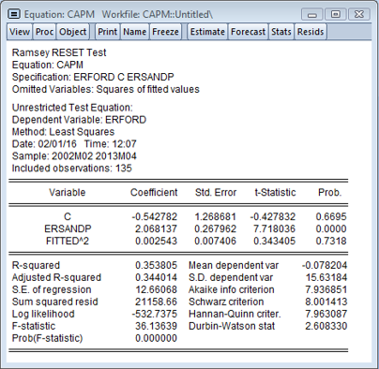
Example 1: Estimate and Test the CAPM
Recursive Regression

Slide 26
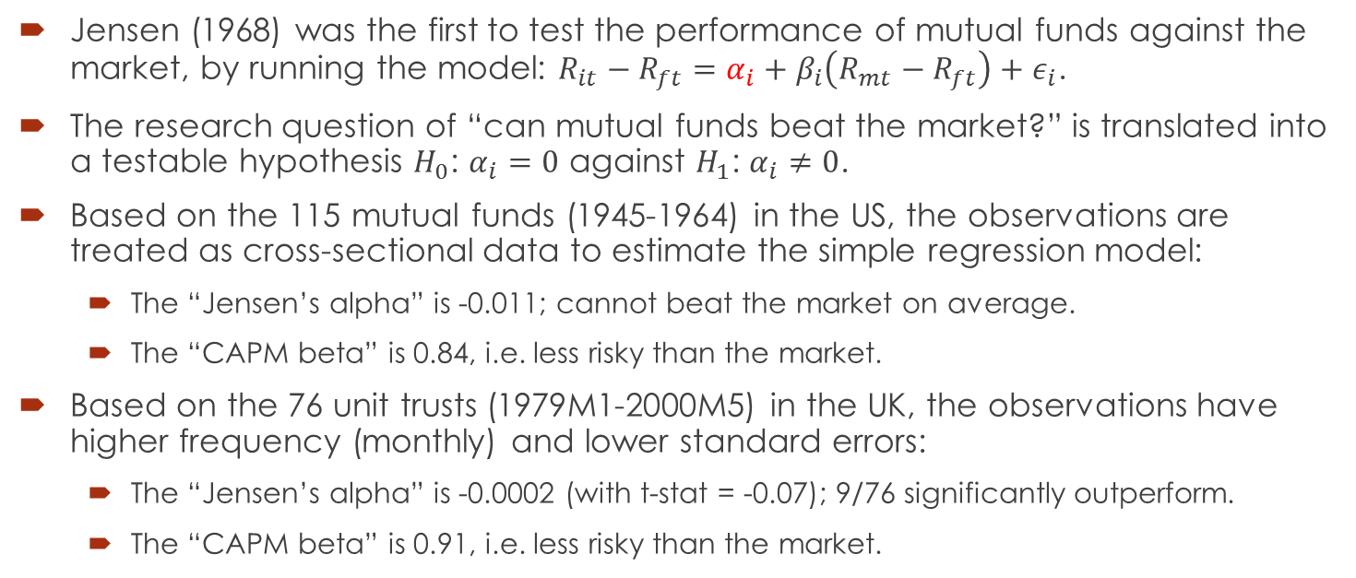
Example 2: Can mutual funds beat the market?
Jensen (1968) was the first to test the performance of mutual funds against the market, by running the model: $R_{it}−R_{ft}=α_{i}+β_{i}\left(R_{mt}−R_{ft}\right)+ε_{i}$.
The research question of “can mutual funds beat the market?” is translated into a testable hypothesis $H_{0}$: $α_{i}=0$ against $H_{1}$: $α_{i}≠0$.
Based on the 115 mutual funds (1945-1964) in the US, the observations are treated as cross-sectional data to estimate the simple regression model:
The “Jensen’s alpha” is -0.011; cannot beat the market on average.
The “CAPM beta” is 0.84, i.e. less risky than the market.
Based on the 76 unit trusts (1979M1-2000M5) in the UK, the observations have higher frequency (monthly) and lower standard errors:
The “Jensen’s alpha” is -0.0002 (with t-stat = -0.07); 9/76 significantly outperform.
The “CAPM beta” is 0.91, i.e. less risky than the market.

Slide 27
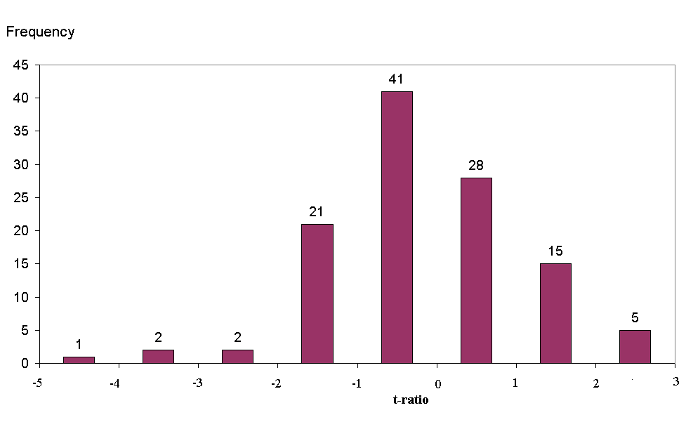
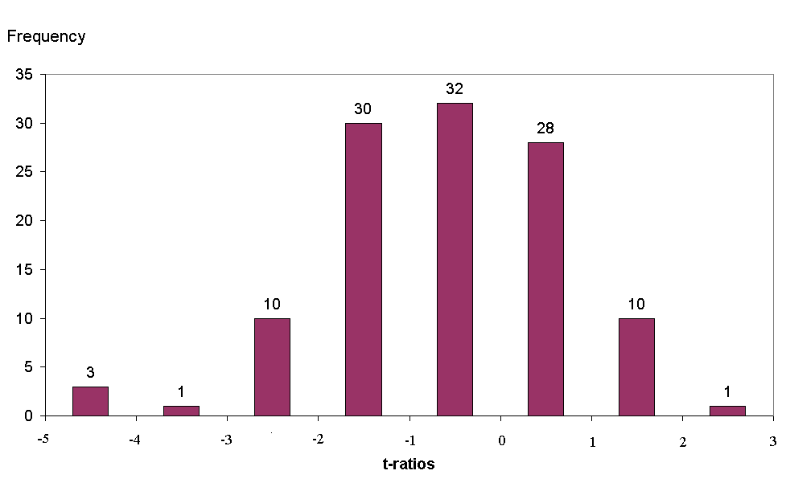
Example 2: Can mutual funds beat the market?
Gross of transaction costs
Net of transaction costs
Source: Jensen (1968) based on the 115 mutual funds (1945-1964)
What is the degree of freedom?
How many funds significantly outperform/underperform?

Slide 28
Summary & Required Reading
We have systematically reviewed (almost) all the techniques related to the classical LRM in a very practical fashion.
My focus is on the big picture, interpretation and application, and the purpose is to facilitate your understanding of the technical derivations behind, NOT to exempt you from it.
A tip: Keep DOING while learning—use it or lose it.
Chapter 3-5, Brooks, C. (2014) Introductory Econometrics for Finance. 3rd Edition. Cambridge University Press.

